Slide 1
___________________________________________________________________________________________________________________________________________________________________________________________________________________________________________________________________________________________________________________________________________________________________________________________________________________________________________________________________________________________________________________________________________________________________________________________________________________________________________________________________________________________________________________________________________

Slide 2
__________________________________________________________________________________________________________________________________________________________________________________________________________________________________________________________________________________________________________________________________________________________________________________________________________________________________________________________________________________________________________________________________________________________________________________________________________________________________________________________________________________________________________________________________________________________________________________________________________________________________________________________________________________________________________________________________________________________________________________________________________________________________________________________________________________________________________________________________________________________________________________________________________________________________________________________

Slide 3
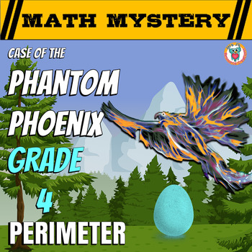
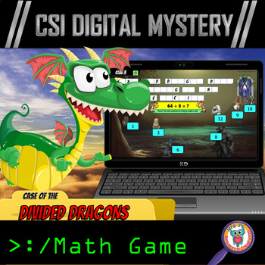
Click here to Follow me on TPT!

