Slide 1
___________________________________________________________________________________________________________________________________________________________________________________________________________________________________________________________________________________________________________________________________________________________________________________________________________________________________________________________________________________________________________________________________________________________________________________________________________________________________________________________________________________________________________________________________________

Slide 2
__________________________________________________________________________________________________________________________________________________________________________________________________________________________________________________________________________________________________________________________________________________________________________________________________________________________________________________________________________________________________________________________________________________________________________________________________________________________________________________________________________________________________________________________________________________________________________________________________________________________________________________________________________________________________________________________________________________________________________________________________________________________________________________________________________________________________________________________________________________________________________________________________________________________________________________________

Slide 3
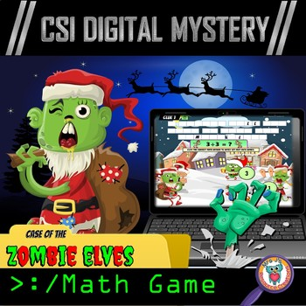
Click here to Follow me on TPT!

