Slide 1
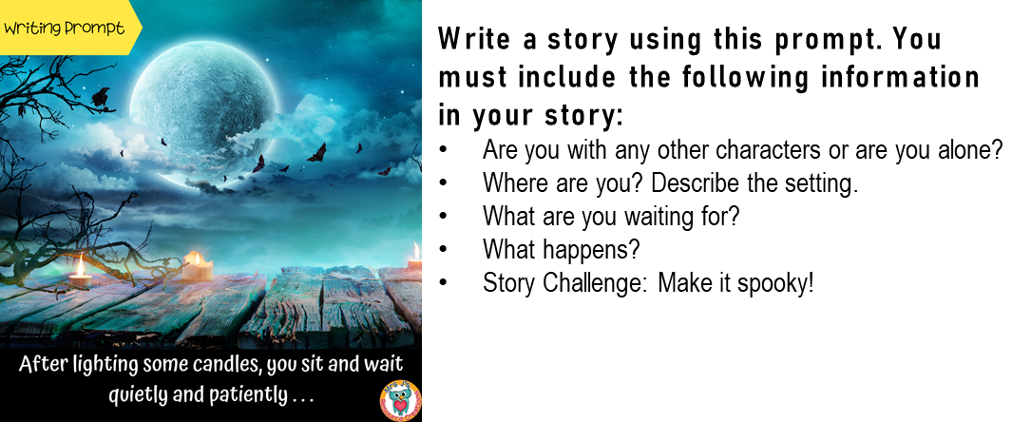
Writing Prompt
Mrs J’s Resource Creations ©
___________________________________________________________________________________________________________________________________________________________________________________________________________________________________________________________________________________________________________________________________________________________________________________________________________________________________________________________________________________________________________________________________________________________________________________________________________________________________________________________________________________________________________________________________________

Slide 2
__________________________________________________________________________________________________________________________________________________________________________________________________________________________________________________________________________________________________________________________________________________________________________________________________________________________________________________________________________________________________________________________________________________________________________________________________________________________________________________________________________________________________________________________________________________________________________________________________________________________________________________________________________________________________________________________________________________________________________________________________________________________________________________________________________________________________________________________________________________________________________________________________________________________________________________________

